Slide 1

Fedor Rychkov

Slide 2
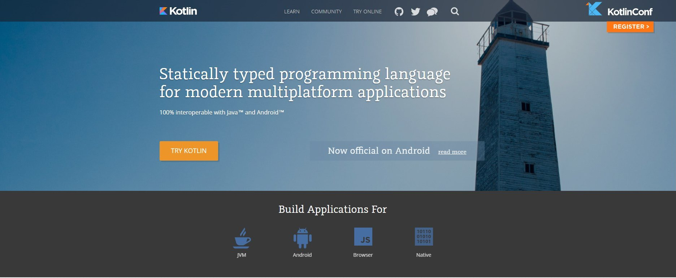
https://try.kotlinlang.org

Slide 3
Basic Syntax

